Slide 1
Federated Name services

Slide 2
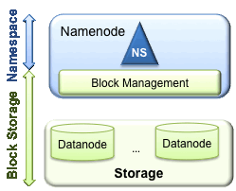
Single Namespace

Slide 3
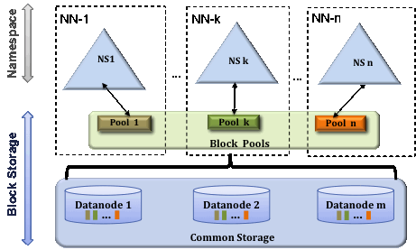
Multiple Namespaces

Slide 4
HDFS Federation
The prior HDFS architecture allows only a single namespace for the entire cluster
A single Namenode manages this namespace
HDFS Federation addresses limitation of the prior architecture by adding support multiple Namenodes/namespaces to HDFS file system

Slide 5
Federation uses multiple independent Namenodes/namespaces.
Able to scale horizontally
Federated Namenodes are independent of each other
Each datanode registers with all the Namenodes in the cluster

